Slide 1
DSC3013 Intro. to Social
Media Analytics (Lec. 10)
Hao PENG
Department of Data Science
City University of Hong Kong
https://haoopeng.github.io/

Slide 2
Agenda
Network Visualization
  Why visualize networks?
  Visualization types & methods
  Visual encoding channels
  Tools and workflows
Paper presentation (last two teams)
Demo of project presentation (Hao)
  How do offline events impact behavior in OSM?

Slide 3
Why visualize networks?
- Networks are complex; visualization makes structure visible
- Reveals communities, bridges, hubs, and connections
- Supports exploratory analysis (patterns you did not expect)
- Communicate findings to non-technical audiences
- Can reveal patterns that metrics alone miss
Key idea: Metrics summarize; visualization reveals.

Slide 4
What visualization adds beyond metrics
Metric
What it tells you
What it misses
Modularity
Strength of community structure
Where communities sit
Degree
Node importance
Which nodes are bridges
Density
Overall connectedness
Where density is concentrated
Clustering
Local triadic closure
Which clusters are isolated
Assortativity
Similarity of connections
What the pattern looks like
Visualization is not decoration - it is part of data analysis & interpretation.

Slide 5
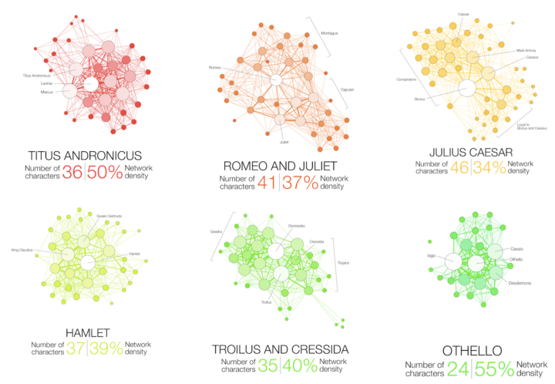
Visualizations convey information
Which novel (book) is the most complex to read?
http://www.martingrandjean.ch/network-visualization-shakespeare/
Notes:
We want to visualize networks for many reasons: appealing, reveal relationships, structure.
Nodes and links
The longest tragedy Hamlet is not the most complex play.

Slide 6
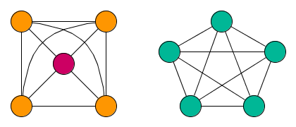
Types of visualization matter
Which node is the most central in the left graph?
Which node is the most central in the right graph?
A visualization of a network can be both revealing and deceiving
Visualization is useful for exploration and hypothesis building
Statistical analyses are needed for hypothesis testing

Slide 7
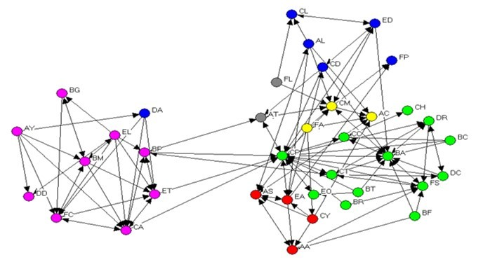
Node-link diagrams
Most common type. Nodes are points, edges are lines.
- Intuitive
- Reveals structure directly
- Works for small and medium networks
Strengths:
Weaknesses:
- Hairball problem at scale
- Layout-dependent
- Edge crossings can mislead
Best for: Communities, social networks, diffusion cascade.

Slide 8
Adjacency matrix
Rows and columns are nodes; cells are edges.
Strengths:
Weaknesses:
- No hairball
- Reveals block structure
- No layout randomness - reproducible
- Not intuitive for general audiences
- Harder to trace paths
- Requires ordering
Best for: Dense networks, community detection validation, reproducibility.

Slide 9
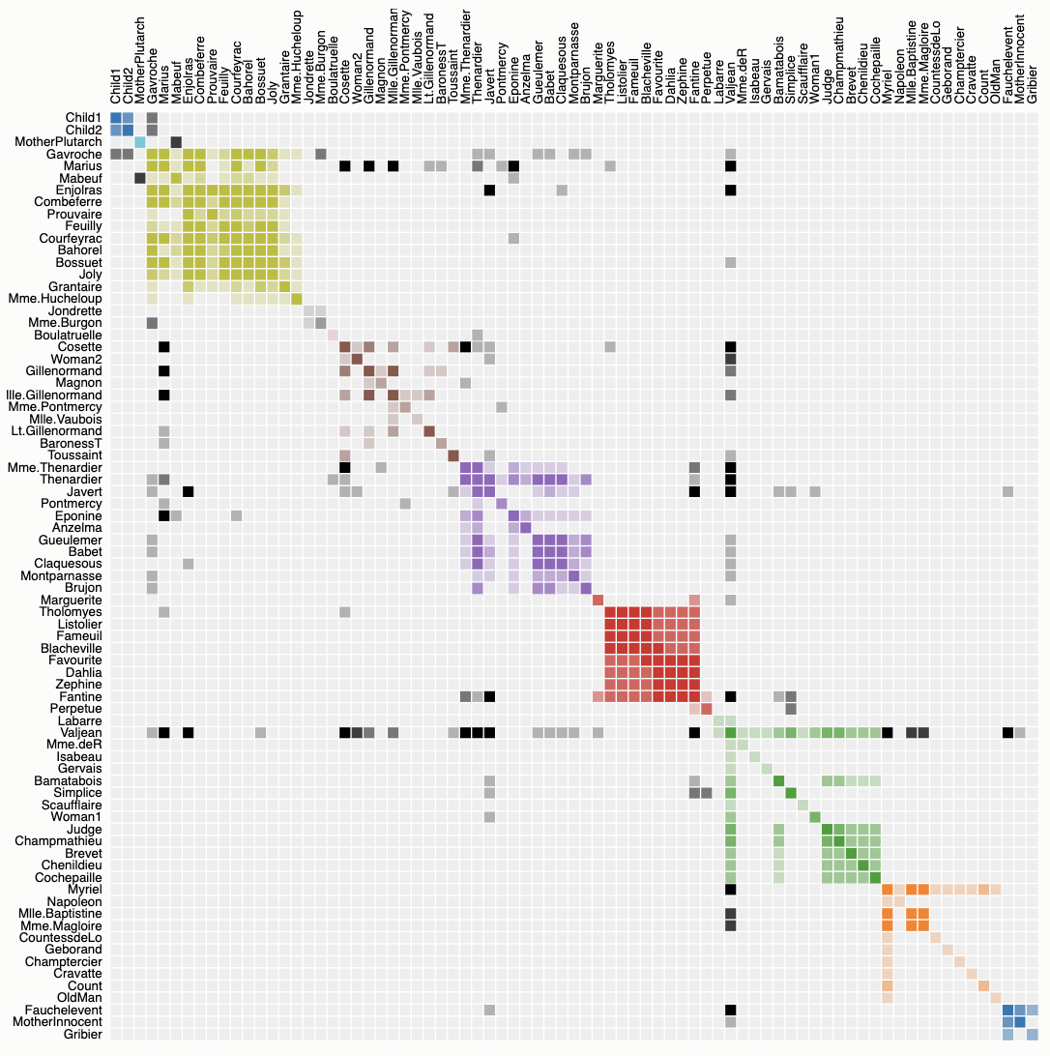
Character co-occurrence network
  https://bost.ocks.org/mike/miserables/

Slide 10
Arc diagrams
Nodes on a line; edges as arcs above.
Strengths:
- Limited to small networks
- Arc crossings grow quickly
- Preserves node order
- Good for sequences
- Good for chronological data
Weaknesses:
Best for: Temporal or sequential data, small-to-medium networks.

Slide 11
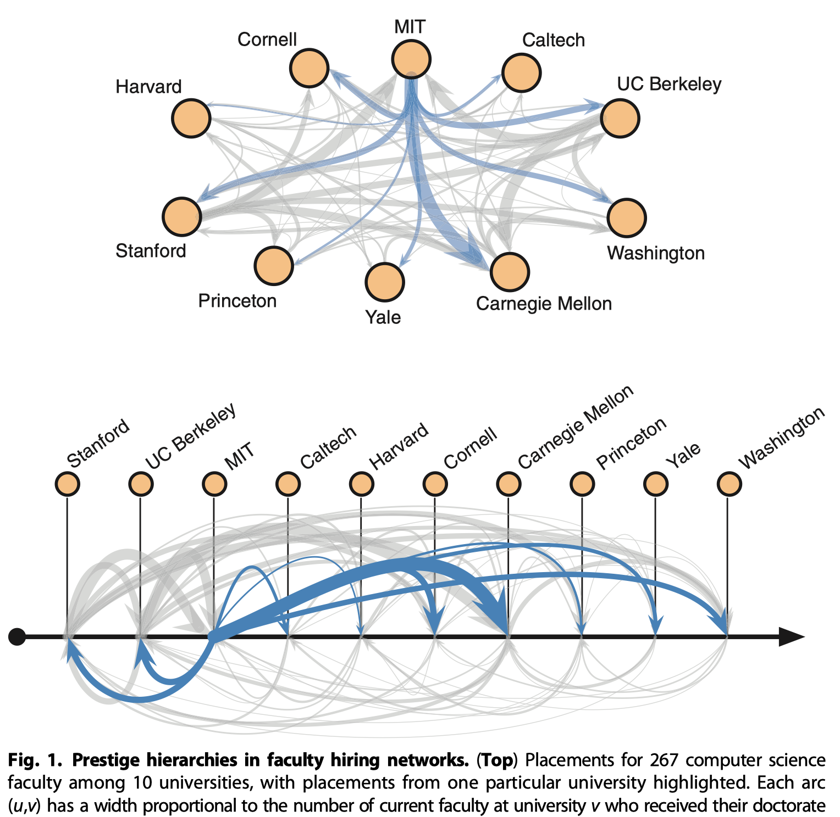
Faculty hiring network
Node positions can reflect institution rank
Clauset et al. Sci. Adv. 2015

Slide 12
Choosing the right type
Question
Type
Who is connected to whom?
Node-link
Which communities exist and how connected?
Node-link or matrix
Is there block structure?
Matrix
Does order matter?
Arc
Match the type to the question, not to fashion / appealing.

Slide 13
Visual encoding channels
Channel
Common uses
Node size
Degree, centrality, follower count
Node color
Community, attribute, category
Node shape
User type, platform, verified status
Edge width
Tie strength, frequency, weight
Edge color
Type of relationship, sentiment
Edge style
Direction (arrows), confidence
Position
Layout output
Rule of thumb:
Every channel should encode something. If it encodes nothing, remove it.

Slide 14
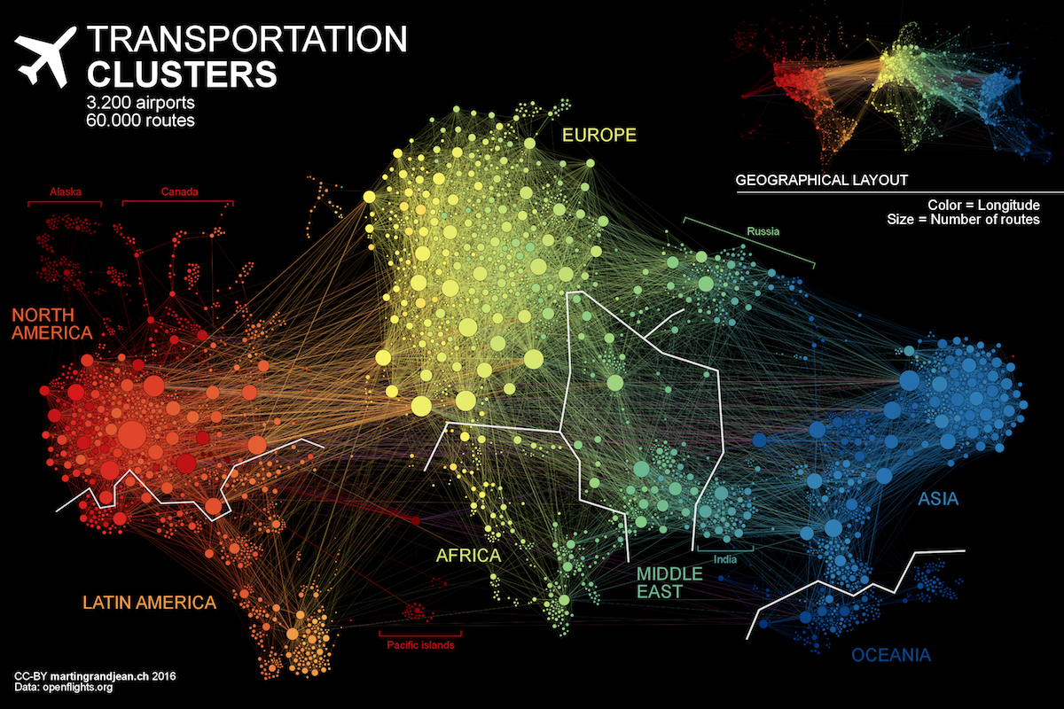
Show node size and color
http://www.martingrandjean.ch/connected-world-air-traffic-network/
Notes:
Geographical clusters

Slide 15
Visualizing large networks
Show groups instead of individual nodes
Show core nodes; hide peripheral nodes
Only show nodes; hide all links for clarity
  Determine node position to preserve node similarities.
  Often use dimension reduction technique: PCA, t-SNE, etc.

Slide 16
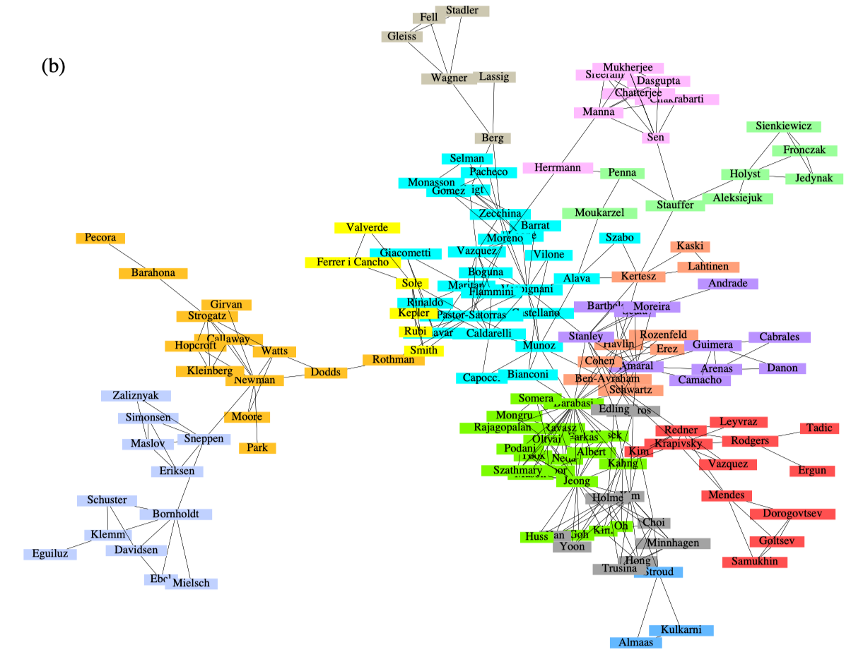
Focusing on communities
A network of Network Scientists

Slide 17
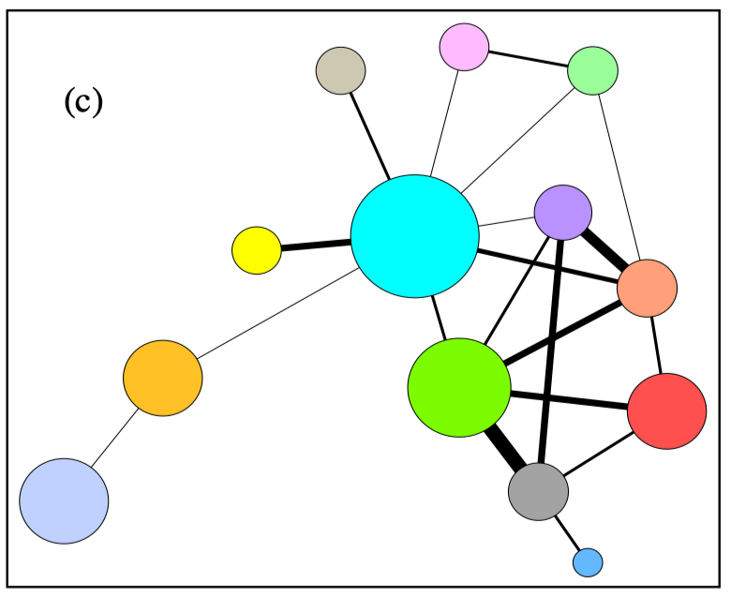
Focusing on communities
Disciplinary and interdisciplinary relationships

Slide 18
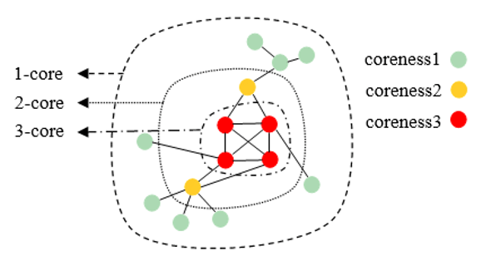
K-score decomposition
K-core: recursively removing all nodes of degree smaller than k, until the degree of all remaining nodes is at least k.
Nodes are said to have coreness k (or, to belong to the k-shell) if they belong to the k-core but not to the (k + 1) - core.
Do red nodes belong to the 2-core?

Slide 19
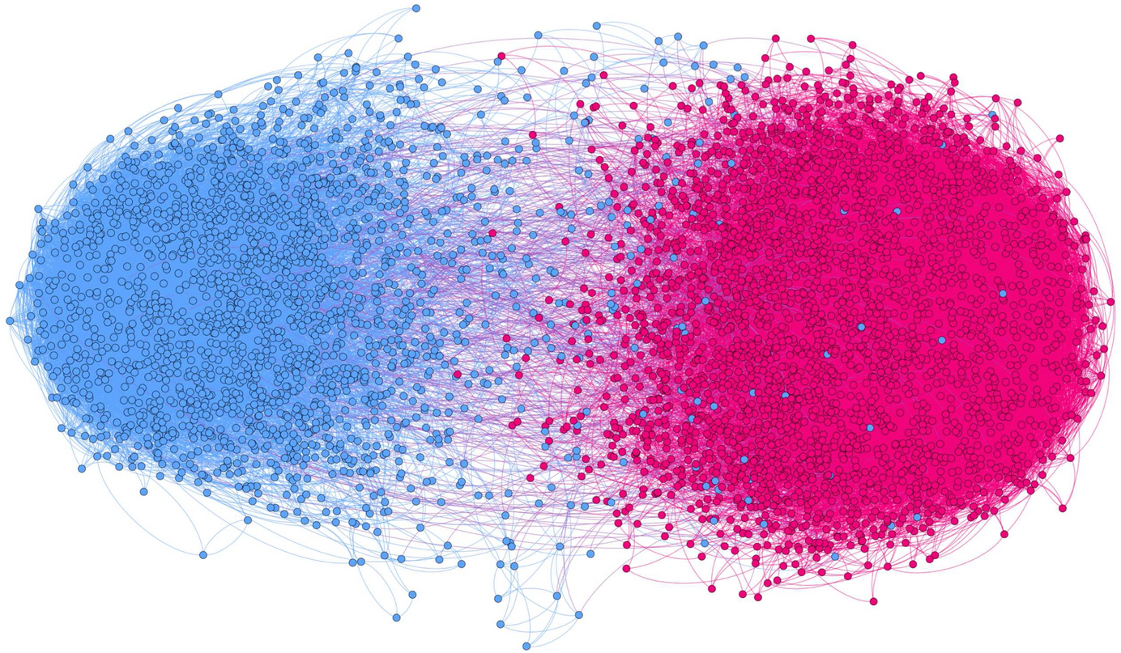
K-score visualization
Example of a politically polarized retweet network (only 3-core nodes are visualized).
Where are the brokers? What’s their ideology?
https://link.springer.com/article/10.1007/s42001-020-00084-7

Slide 20
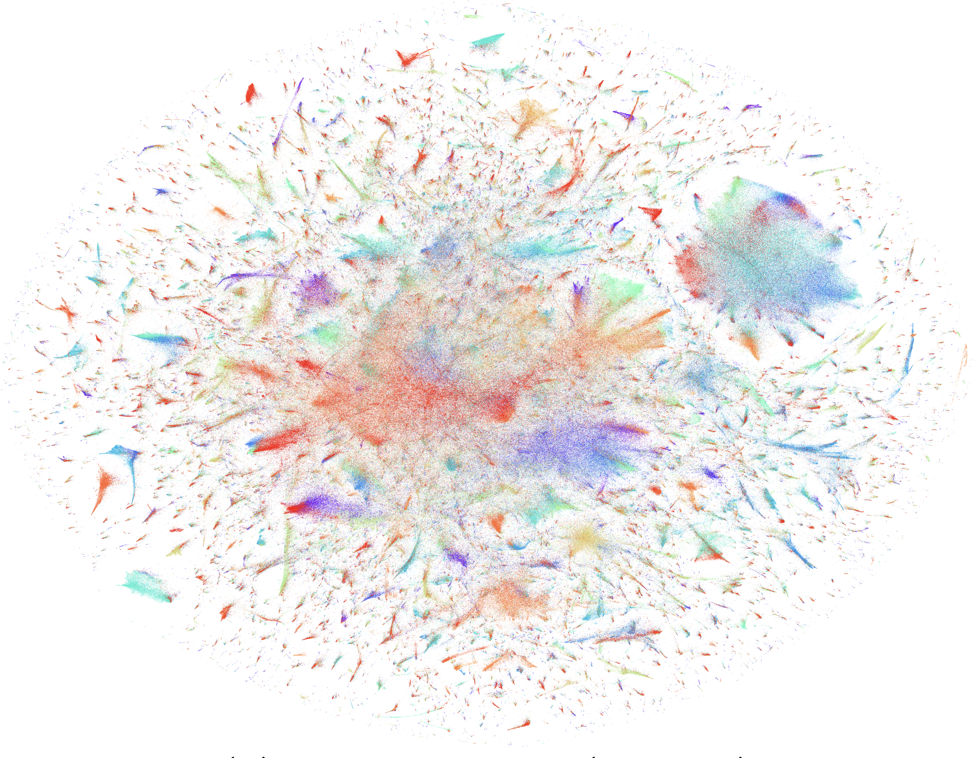
Dimension reduction
~4 million users on LiveJournal site (100D user vector from Node2vec)
Impossible to show links
Tang et al. WWW. 2016

Slide 21
Python - NetworkX + Matplotlib
import networkx as nx
import matplotlib.pyplot as plt
G = nx.karate_club_graph()
pos = nx.spring_layout(G, seed=42)
nx.draw(G, pos, with_labels=True,
node_color="steelblue",
edge_color="gray")
plt.show()
Strengths:
Weaknesses:
Fully programmable
Integrates with data analysis
Limited interactivity (static network)
Manual aesthetics, depend on choices
Additional Python libraries:
- graph-tool: fast layouts and rendering for large networks
- igraph: efficient, many layout algorithms
- pyvis: interactive HTML networks

Slide 22
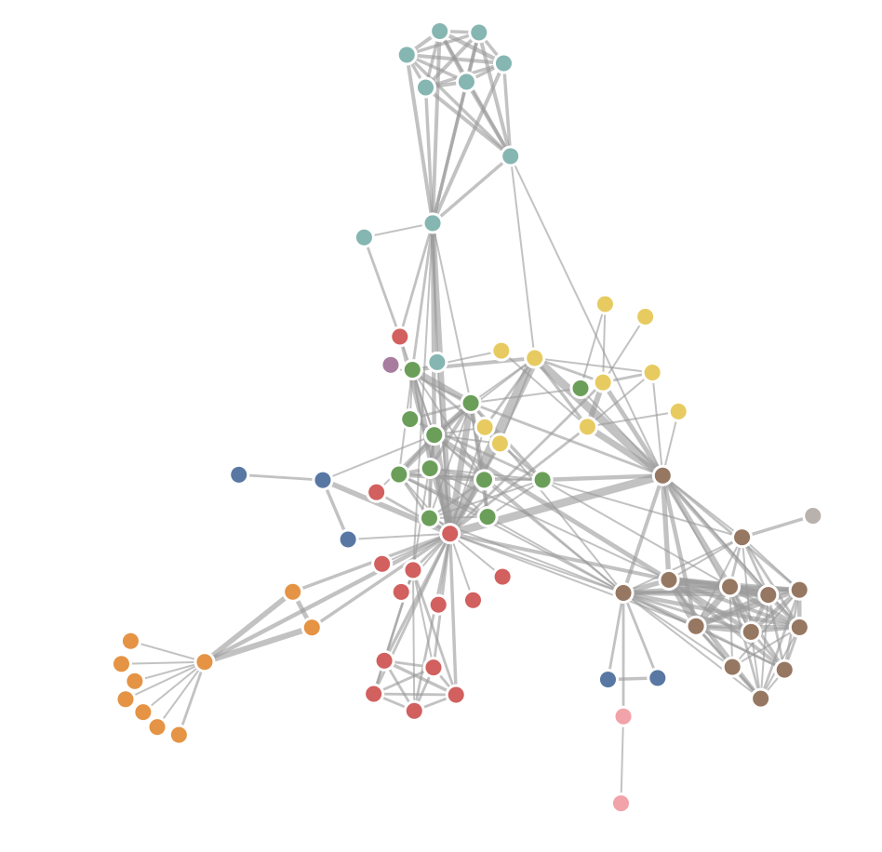
Interactive visualization
D3.js: A JavaScript library for producing dynamic & interactive data visualizations purely in web browsers (cross-platform).
  Pre-requisite skills: html, css, javascript
  Books: “Javascript by Example”
  Online sources: “D3 in Depth” (https://www.d3indepth.com/)
The same “character co-occurrences network” in D3:
  https://observablehq.com/@d3/force-directed-graph-component

Slide 23
Workflow for a good network figure
1. Define the question - what should the figure reveal?
2. Reduce the network - filter, aggregate, or backbone
3. Choose a representation - node-link, matrix, arc diagram
4. Encode meaningful variables - size, color, width
5. Reduce clutter - alpha, labels, filtering
6. Annotate - title, legend, key structures
7. Check reproducibility - record the random seed

Slide 24
Project Demo
Event-Driven Analysis of Crowd Dynamics in a Racial Political Online Social Movement

Slide 25

Study motivation
Social movements are important for democracy in modern society.
Social movements can transform radical ideas into practical policies.
https://ru.123rf.com/

Slide 26
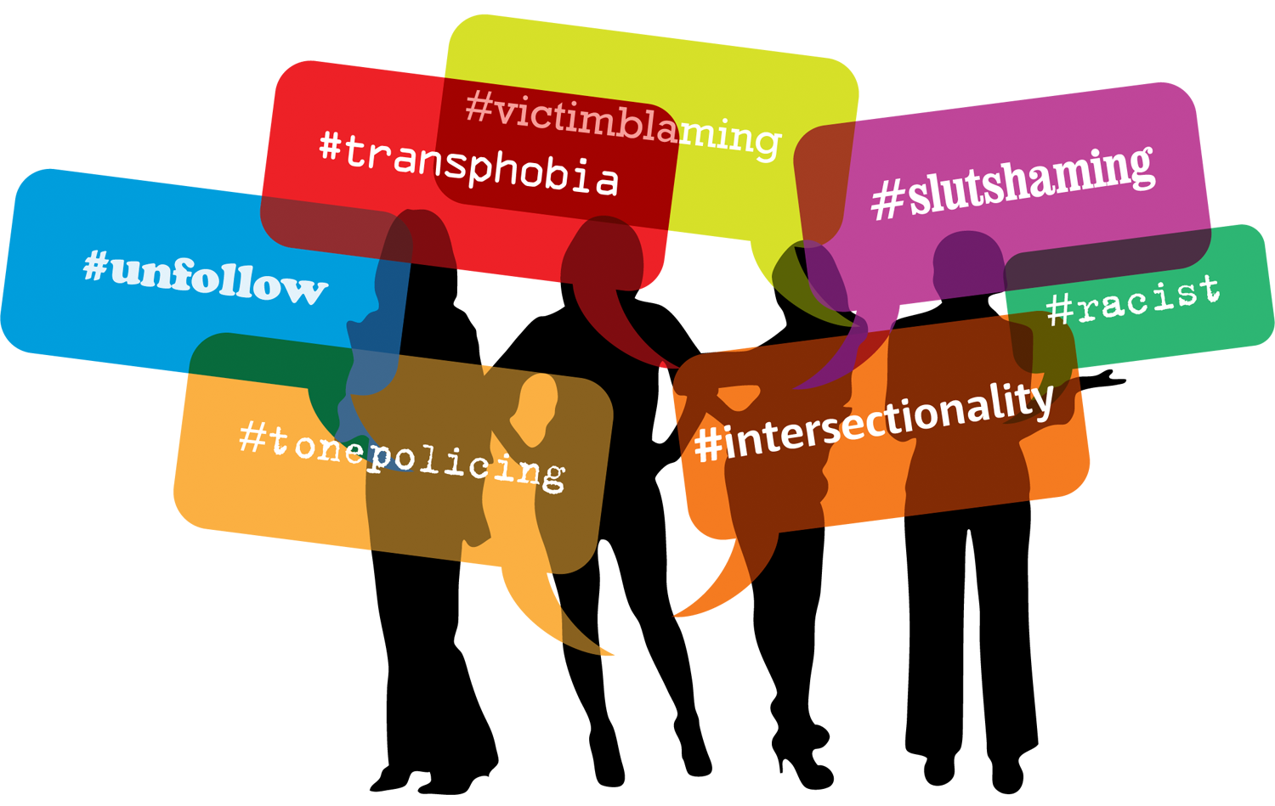
Rise of Online Social Movement (OSM)
Social media lowered the cost of participating in online activism.
They often come in the form of posts with political hashtags.
https://storify.com/hollycradd/feminist-social-media-movements

Slide 27

Study context (literature review)
Arab Spring 2010; Egyptian Revolution 2011; Occupy Wall Street 2011
Information diffusion; Recruitment process; Movement framing
(Starbird and Palen, 2012; González-Bailón et al., 2013; Stewart et al., 2017)
Research show that crowd behavior are often linked to key offline events.
(Spiro et al., 2016; De Choudhury et al., 2016; Varol et al., 2014)
How do different types of offline events affect crowd behavior in online social movements?
Notes:
Many studies have focused on different online social movements, including …
They investigate different topics such as, …
Although they studies different online movements that are driven by different political agenda, they seem to convey a similar message: …
However, little is known about how different …

Slide 28
Why would events matter in OSM?
Online and offline scenarios are often intertwined.
Online participation can be triggered by offline events.
Offline protests can be organized in online platforms.
Notes:
When we talk about social movements, we should pay attention to both the online world and offline world.
The interplay between two worlds are interesting to explore.
Previous studies put much focus on the Online to Offline direction.
e.g. some studies view social media as a causal factor that can drive protest movements.
However, there is not much work exploring the offline to online direction.

Slide 29
#BLM as a case study
Offline events
Crowd behavior online
Police violence events
Heightened protests
Other times (normal)
Sustained participation
Continued interaction
Notes:
In this study, we focus on the BLM online movement, a worldwide activist movement against police violence and racial discrimination. BLM has both extensive online participation and various events on the ground.
In the context of BLM:
Police violence such as Shootings can create moral shocks and spur recruitment;
Protests provide a channel for activists to gain awareness, articulate core beliefs, and suggest policy solutions;
There are also other times when noting is happening and people just participate, maybe they are self-motivated.
So it’s likely that different events would affect crowd dynamics differently.
More specifically, we want to investigate.

Slide 30
Dataset
Online data
53 BlackLivesMatter related hashtags;
36M tweets (each contains at least one #);
27M retweets;
Time range: 01/02/2014 - 05/10/2015;
Offline data
5 most prominent police violence events;
(Eric Garner, Michael Brown, Tamir Rice, Walter Scott, Freddie Gray)
Protest events: elephrame.com;
Notes:
Replies with no hashtags are not included. Probably missing one shooting around 2014/10.
Here is our dataset, which consists of two parts.
For the online part,
The most prominent ones;
It includes every tweet that contained one of these #.

Slide 31
Event categorization of online dataset
Defining a time window w around each event e:
violence period: [te, te + w];
protest period: [te - w, te + w];
combine adjacent periods with the same event type;
violence overrides protest in case of overlap;
let w = 7 days (Gallagher et al., 2018)
activities often follow violence events (unexpected);
activities can happen before and after protests;
Notes:
One difficulty is to identify time periods that correspond to different events. To address this issue:
We create an event categorization of the whole time period by …

Slide 32
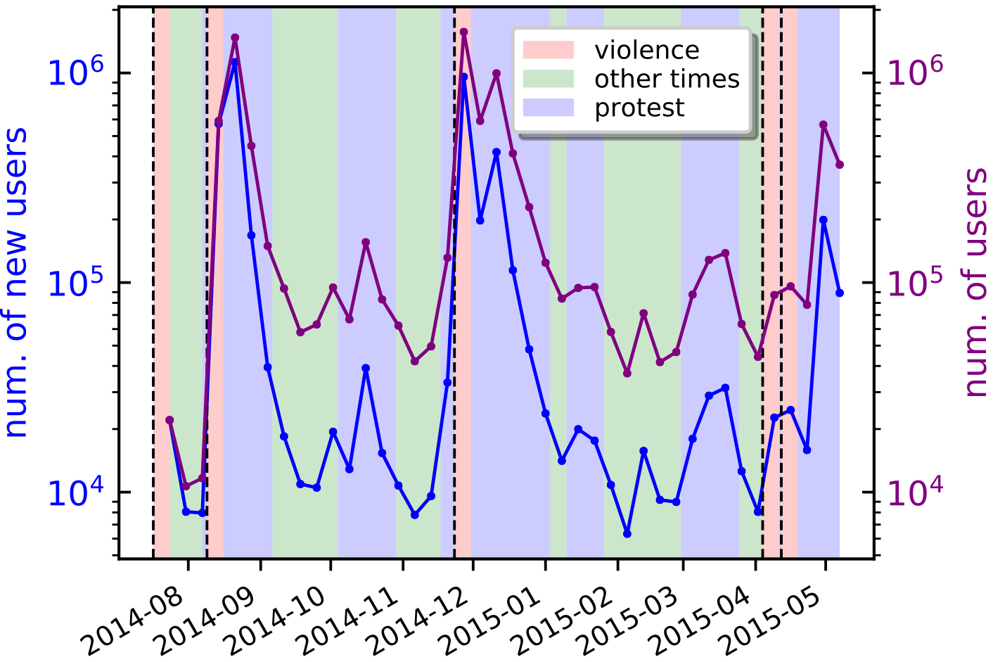
Event categorization of online dataset
The background bins: created using offline events
Two line plots: calculated based on the online dataset
Notes:
The two line plots show the # new users and # users in each one-week time window starting from Eric Garner. This fig. clearly shows that events are driving force to mobilize people around the movement online.

Slide 33
Research Question 1
How arriving at the movement during a type of event is related to continued user participation in the BLM OSM?
Notes:
Next, I analyze the dynamics of user commitment / social interaction as a function of offline events;

Slide 34


User Participation
Measure future commitment along three dimensions:
posted another tweet or not (binary);
num. of tweets posted (frequency);
num. of days with at least one tweet (persistence);
t weeks
t weeks
Protest
Violence
Protest
Violence
Other times
Time
Notes:
We investigate user commitment by looking at their future participation within t weeks after they joined the movement along three dimensions.
Some users post 1,000 tweets a day while disappear there after.

Slide 35
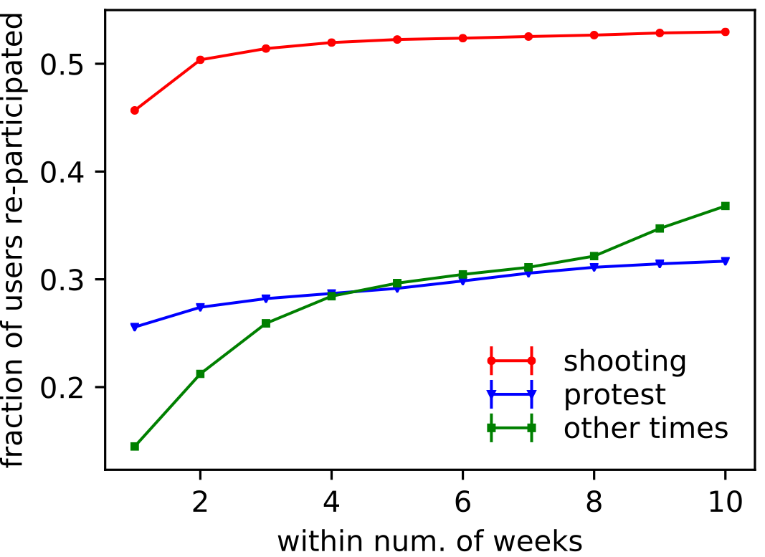
How likely are users combing back?
need controls!

Slide 36
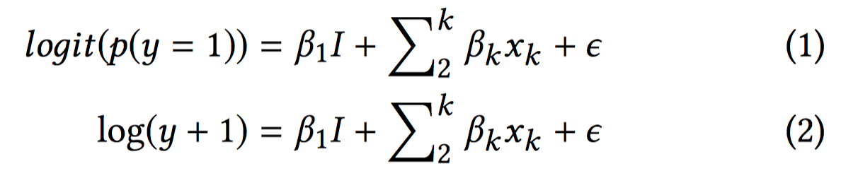
Regression framework
each user is a data point (3.8 million);
focus on the event type of their first tweets;
control for temporal factors and user attributes;
for t in [1, 10]:
    for each measure y:
    use y as the dependent variable;
    the same set of control variables;
    independent variables: event type + controls;
Notes:
To avoid right censoring bias, we focus on the same set of users for whom we can track their future participation for at least 10 weeks.

Slide 37
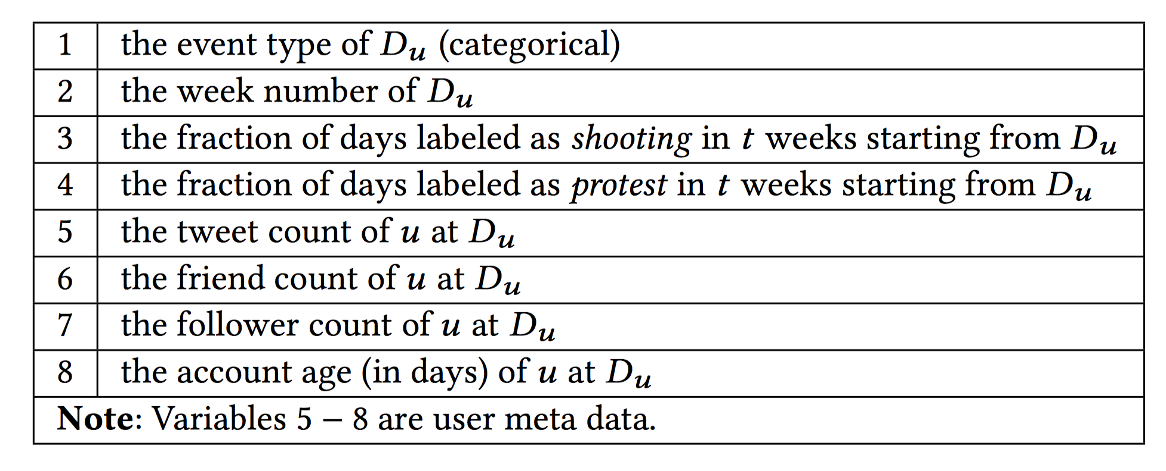

Regression framework
Independent Variables
(focus) Event type
Temporal factors
User attributes
Focus is not on prediction accuracy, but coefficients of Events;
Notes:
Modeling re-participation dynamics is complex. In addition to the events happening when they join, many other factors can directly influence users’ re-participation behavior, such as the ordering of events following their initial involvement. To test whether the event during which users join the movement is related to their future participation, I utilize a regression framework to control for potential confounds.
Variables 2−4 take into account the fact that users will have different timelines when we align them according to their starting time in the movement, and thus can control for the influence of future events—one can, for instance, be more likely to return to the movement if there is an upcoming shooting event since these events act as magnets.
Variables 5 − 8 control for the effect that can be explained by the difference between user attributes.

Slide 38
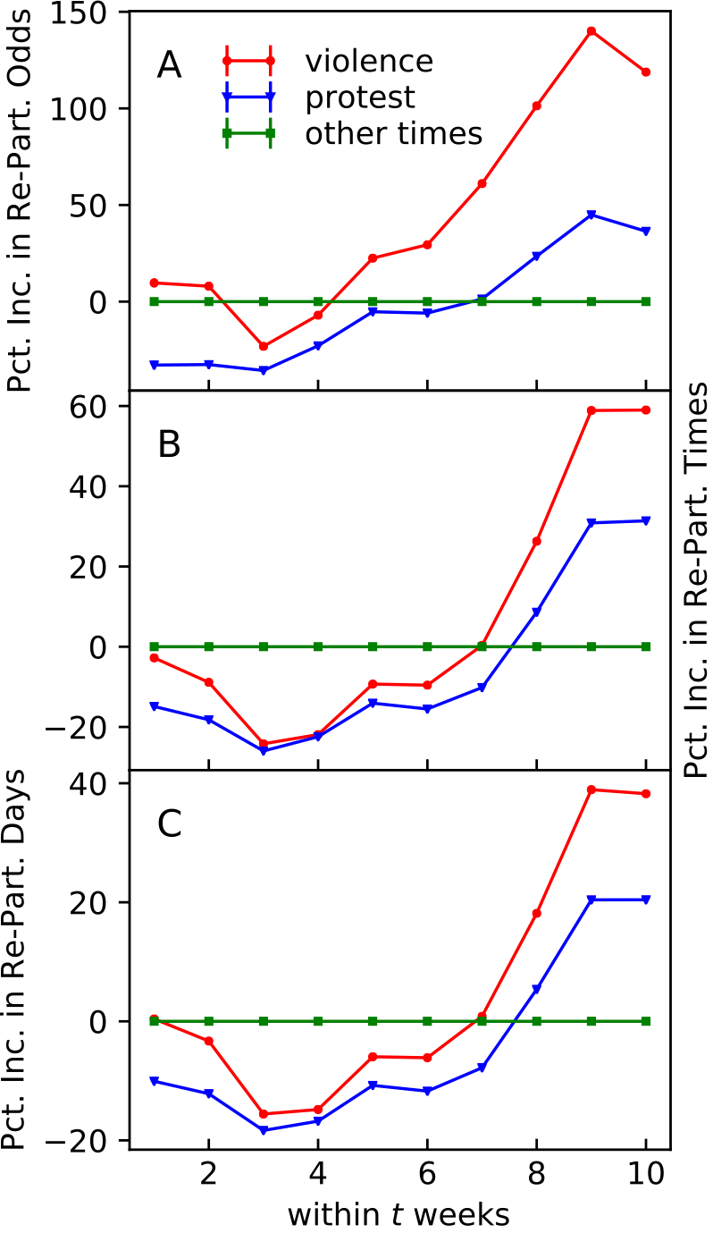
Key finding 1
Re-participate or not?
Use other times as the baseline group;
Report the perc. increase for violence and protest;
Short term and long term effects for both groups;
Re-participation frequency
Re-participation persistence
the tracking window

Slide 39
Research Question 2
How starting a tie (interaction between a pair of users) during a type of event relates to its future occurrence?
Notes:
Next, I analyze the dynamics of user commitment / social interaction as a function of offline events;

Slide 40


Social Interactions
Measure tie strength along three dimensions:
retweet again or not? (binary);
num. of retweets (frequency);
num. of days retweeted (persistence);
t weeks
t weeks
Protest
Violence
Protest
Violence
Other times
Time
Notes:
Similarly, I consider a retweet as an interaction between two users. And I investigate sustained communication by looking at their future retweeting behavior along three dimensions.
Similar to user participation, many factors can influence a tie’s future interaction. To test whether the creation time (event type) of a tie is related to its recurring patterns, I use the same regression framework to control for possible confounding factors.

Slide 41
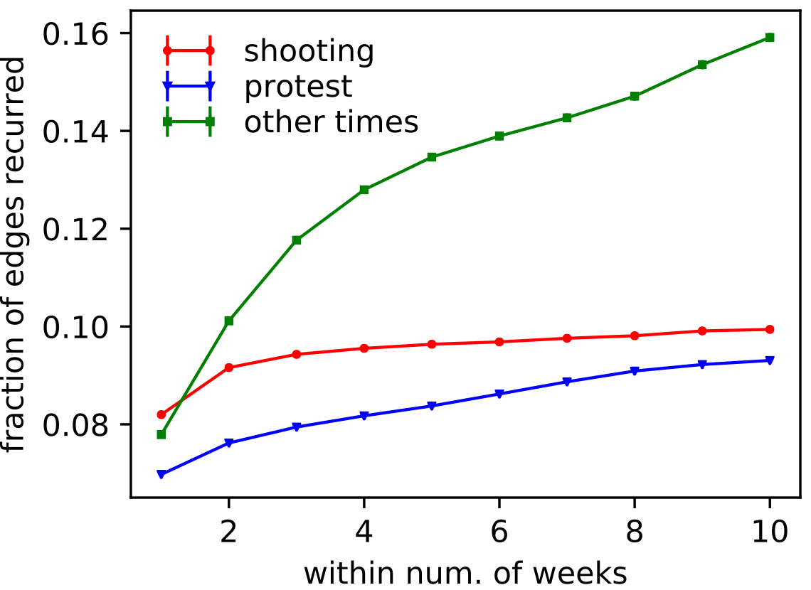
How likely do interactions recur?
need controls!

Slide 42
Regression framework
each pair of users is a data point (17 million);
focus on the event type of their first retweets;
control for temporal factors and user attributes;
for t in [1, 10]:
    for each measure y:
    use y as the dependent variable;
    the same set of control variables;
    independent variables: event type + controls;

Slide 43
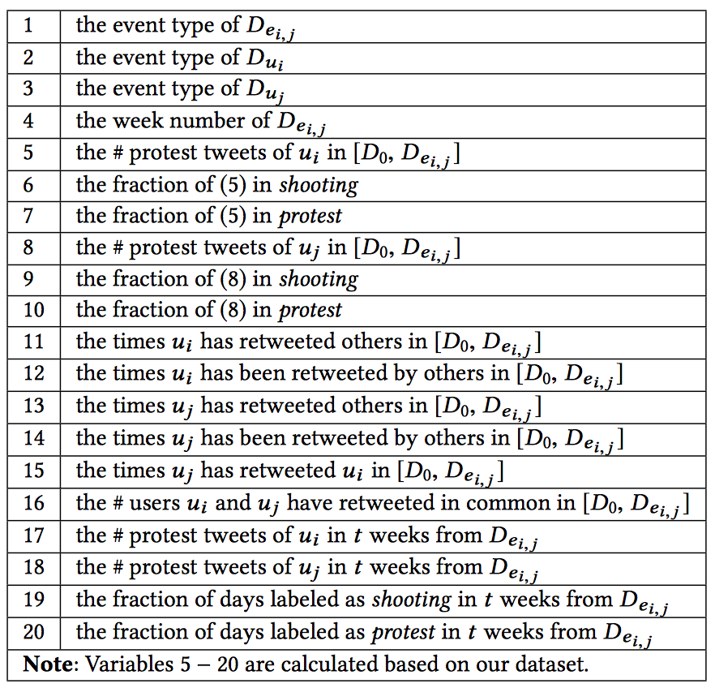
Regression framework
(focus) Event type
Temporal factors
User activities
Prior interactions
Notes:
I define D0 as the time of the first tweet in the dataset. Variables 2 − 20 are used as controls in the regression models, which capture the variations between ties’ creation time in the movement (4, 19, 20), the tendency for users to retweet (11, 13), the tendency for users to be retweeted (12, 14), users’ activity level prior to and after tie creation (5 − 10, 17, 18), number of users they retweeted in common (16), and users previous interactions (15), etc.

Slide 44
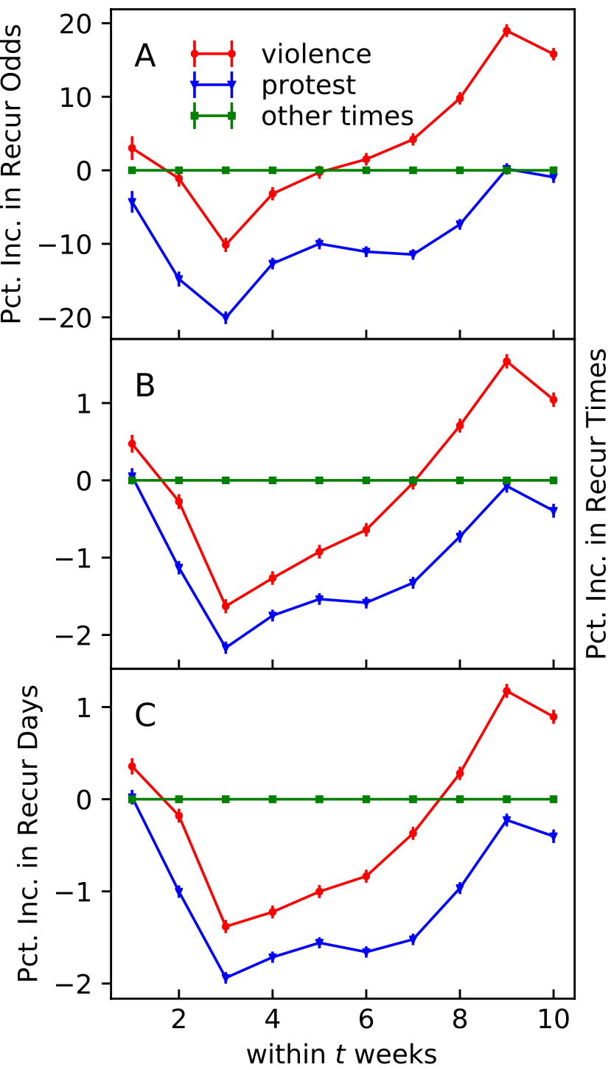
Key finding 2
retweet or not?
num. of retweets
num. of days retweeted
other times: baseline;
violence: short term and long term effects;
protest: ties are less likely to be sustained overall;

Slide 45
Take-away, Implication, Limitation
Police violence and protest events have both short term and long term effects on user commitment in the BLM OSM.
Interactions formed during violence events are more likely to be sustained than those formed during other times, with the latter expressing more engagement than the protests group.
Implication for policymakers, movement organizers, and online social movement observers. e.g. encourage newcomers during other times.
Limitations
          Only studied one political event
          Unclear if results generalize to other OSM
          Cannot claim causal impact of events (unobserved confounds)
Notes:
In this work, we studied how offline events affect crowd dynamics online. We found that…
Why each of these is happening?
Higher level Implications
For Event Organizers: strategies to engaged people.
Future work: What generates this? Content?

Slide 46
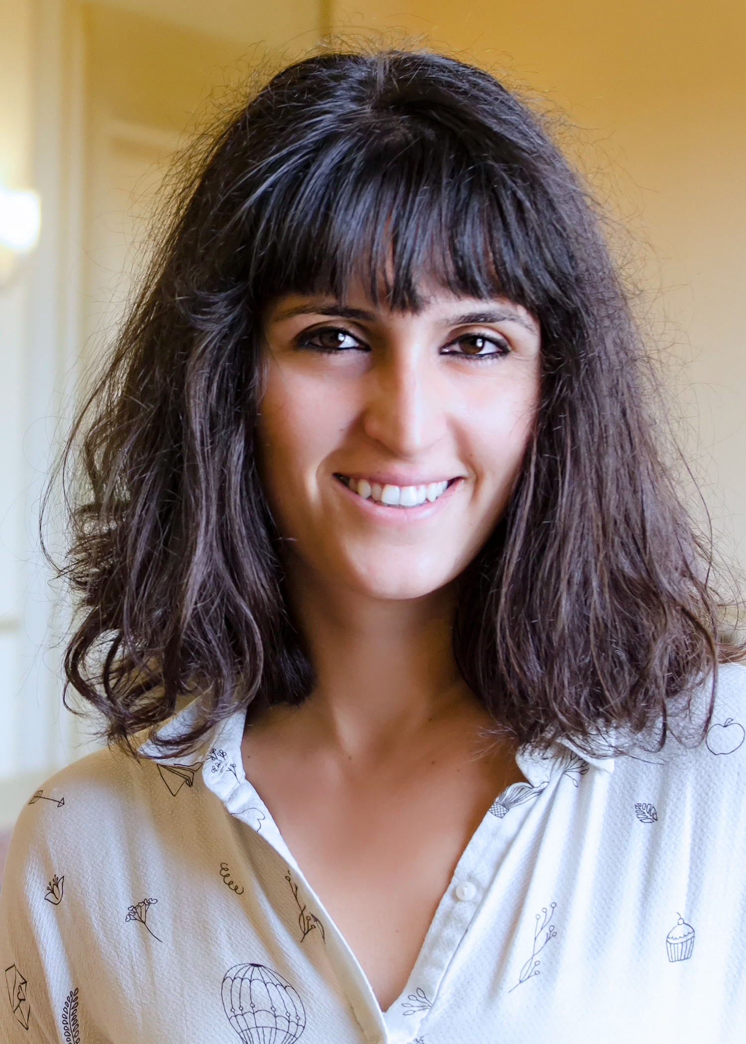
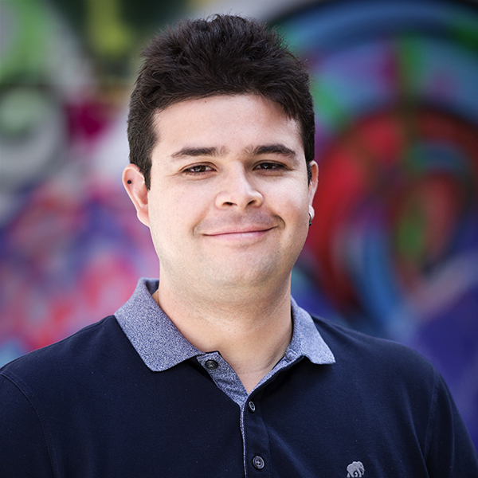
Teammates & Acknowledgement
Ceren Budak
Daniel M. Romero

Slide 47
Questions?

Slide 48
Course notes
Next week
  Ethics in SMA
  Tutorial on Net. Visualization
  Review of final exam
Weeks after next week
  Group project presentation
  Practice a few times in advance!
  Slides due on Nov 16 (every team)

